Slide 1
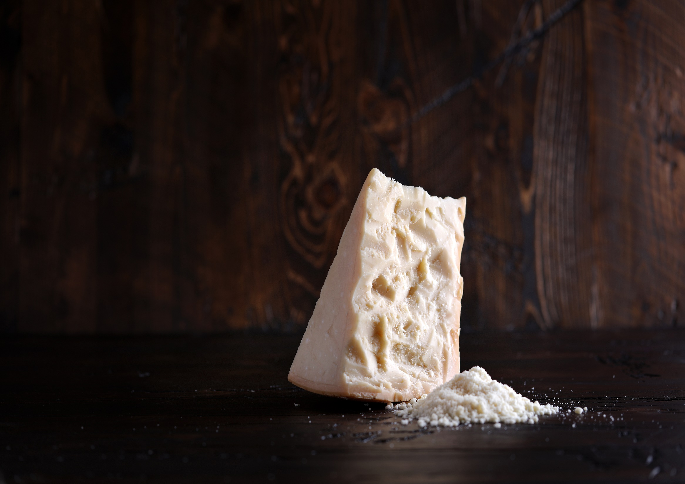
Crafting Distinction
Caputo Cheese 2050 N. 15th Ave., Melrose Park, IL 60160
Tel: 708-450-0074 Fax: 708-681-1802 www.caputocheese.com

Slide 2
A Family Tradition since 1978
From classic Caputo grated cheeses, to our award-winning Fresh Mozzarella line, Caputo Cheese products possess the quality, flavor and consistency that only high standards and family pride can produce. The Caputo family and family of employees are dedicated to providing Old World flavor and New World service in a state-of-the-art facility that focuses on precision, quality, and safety.
Our Mission
We are committed to being the leading manufacturer of the highest quality dairy products. We strive to earn the loyalty of our customers by offering superior quality, consistency, and customer satisfaction while paying attention to your bottom line. Employee enthusiasm and dedication, along with innovation, and family pride, are the driving force in our pursuit of customer satisfaction.

Slide 3
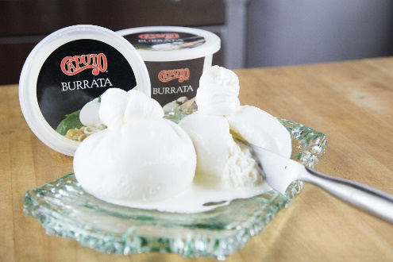
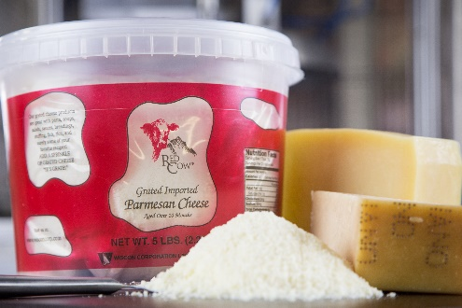
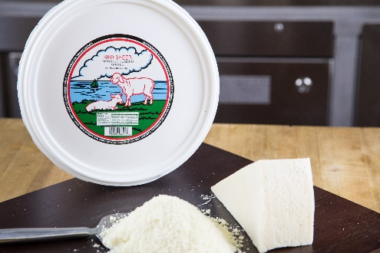
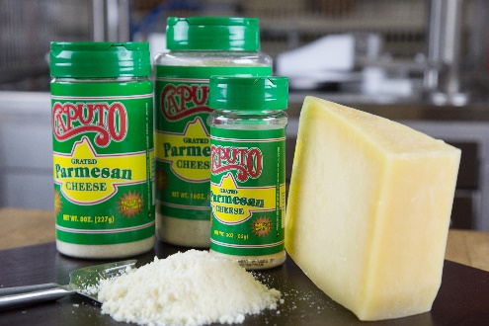
Company Profile
Top ten cheese manufacturer and processor in the United States
Exclusive Partnerships with Cheese Manufacturers all over the world
Manufacturing plant In Melrose Park, IL
Operating approximately166,000 total sq. ft. within multiple facilities
Family business operating for more than 40 years
Brands- Caputo, Red Cow, Red Sheep, Grate Wiscon, and Private Label
Key Products- Parmesan, Romano, Asiago, Fresh Mozzarella, Ricotta and
Processed hard cheeses: grated, shredded, shaved, chopped
Packaging- Industrial, private label, foodservice, retail
Packaging capacity ranging from 3.5 grams up to 50 lb
Hard Italian Cheese Capacity- 700,000 lbs. a week (single shift). Current level of production 60%
Fresh Mozzarella Production- 50,000 lbs. a week (single shift). Current level of production 50%

Slide 4
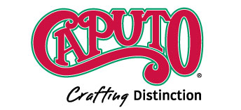
Our Process
At Caputo Cheese, we specialize in the processing of Italian cheeses, including Parmesan, Romano, Parmigiano-Reggiano, and our own award-winning Fresh Mozzarella and Ricotta line. Whether a Caputo brand cheese, or customer specific blends, Caputo Cheese can fulfill your needs.
As a top ten processor and manufacturer, we are dedicated to providing the best customer service in the industry. From major manufacturers, distributors, restaurants, and retailers, to mom and pop pizzerias, and retail stores, Caputo delivers the quality, consistency and service that our customers have come to expect.

Slide 5
Caputo’s History
Family owned business incorporated in 1978 by Pasquale and René Caputo
Pasquale starts shredding Italian cheeses for pizza places throughout Chicago in the early 80’s and began cheese grating and shredding in a 5,000 sq. ft. facility in Chicago
1991-Caputo Cheese Expanded to 50,000 sq. ft. in Melrose Park, IL
Natale Caputo becomes President in 1994
1994-Caputo Cheese Market opens in Melrose Park
2000-Caputo added an additional 50,000 sq. ft. in Melrose Park
2004-A 30,000 sq. ft temperature and humidity controlled cooler was added for aging and storing hard Italian cheese. The cooler has capacity for 2100 pallets, and 5.5 million pounds of cheese.
2006- Corporate offices and dry storage add another 36,000 sq. ft. to the Melrose Park facilities
2009 Caputo opens a second Cheese Market in Lake Forest
2015 Caputo purchases a 50,000 sq. ft. land lot for future growth opportunities
2019-A professional kitchen is created for wholesale customers to do R&D on site

Slide 6
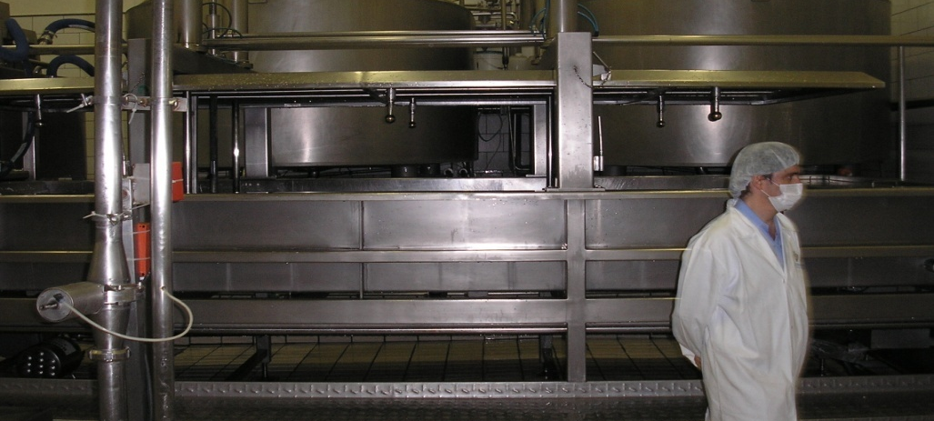
Sanitation & Safety: Food Safety Is Our Number One Priority
SQF level 2 Certified for food manufacturing
Full time in house QA Team
In-house lab testing micro and bio
HACCP Program
Metal detectors on every line
IL inspected monthly
FDA Inspected twice a year
NSF inspected with pass
US Vet Inspected
Monthly personnel meetings
IL Plant #17-67

Slide 7
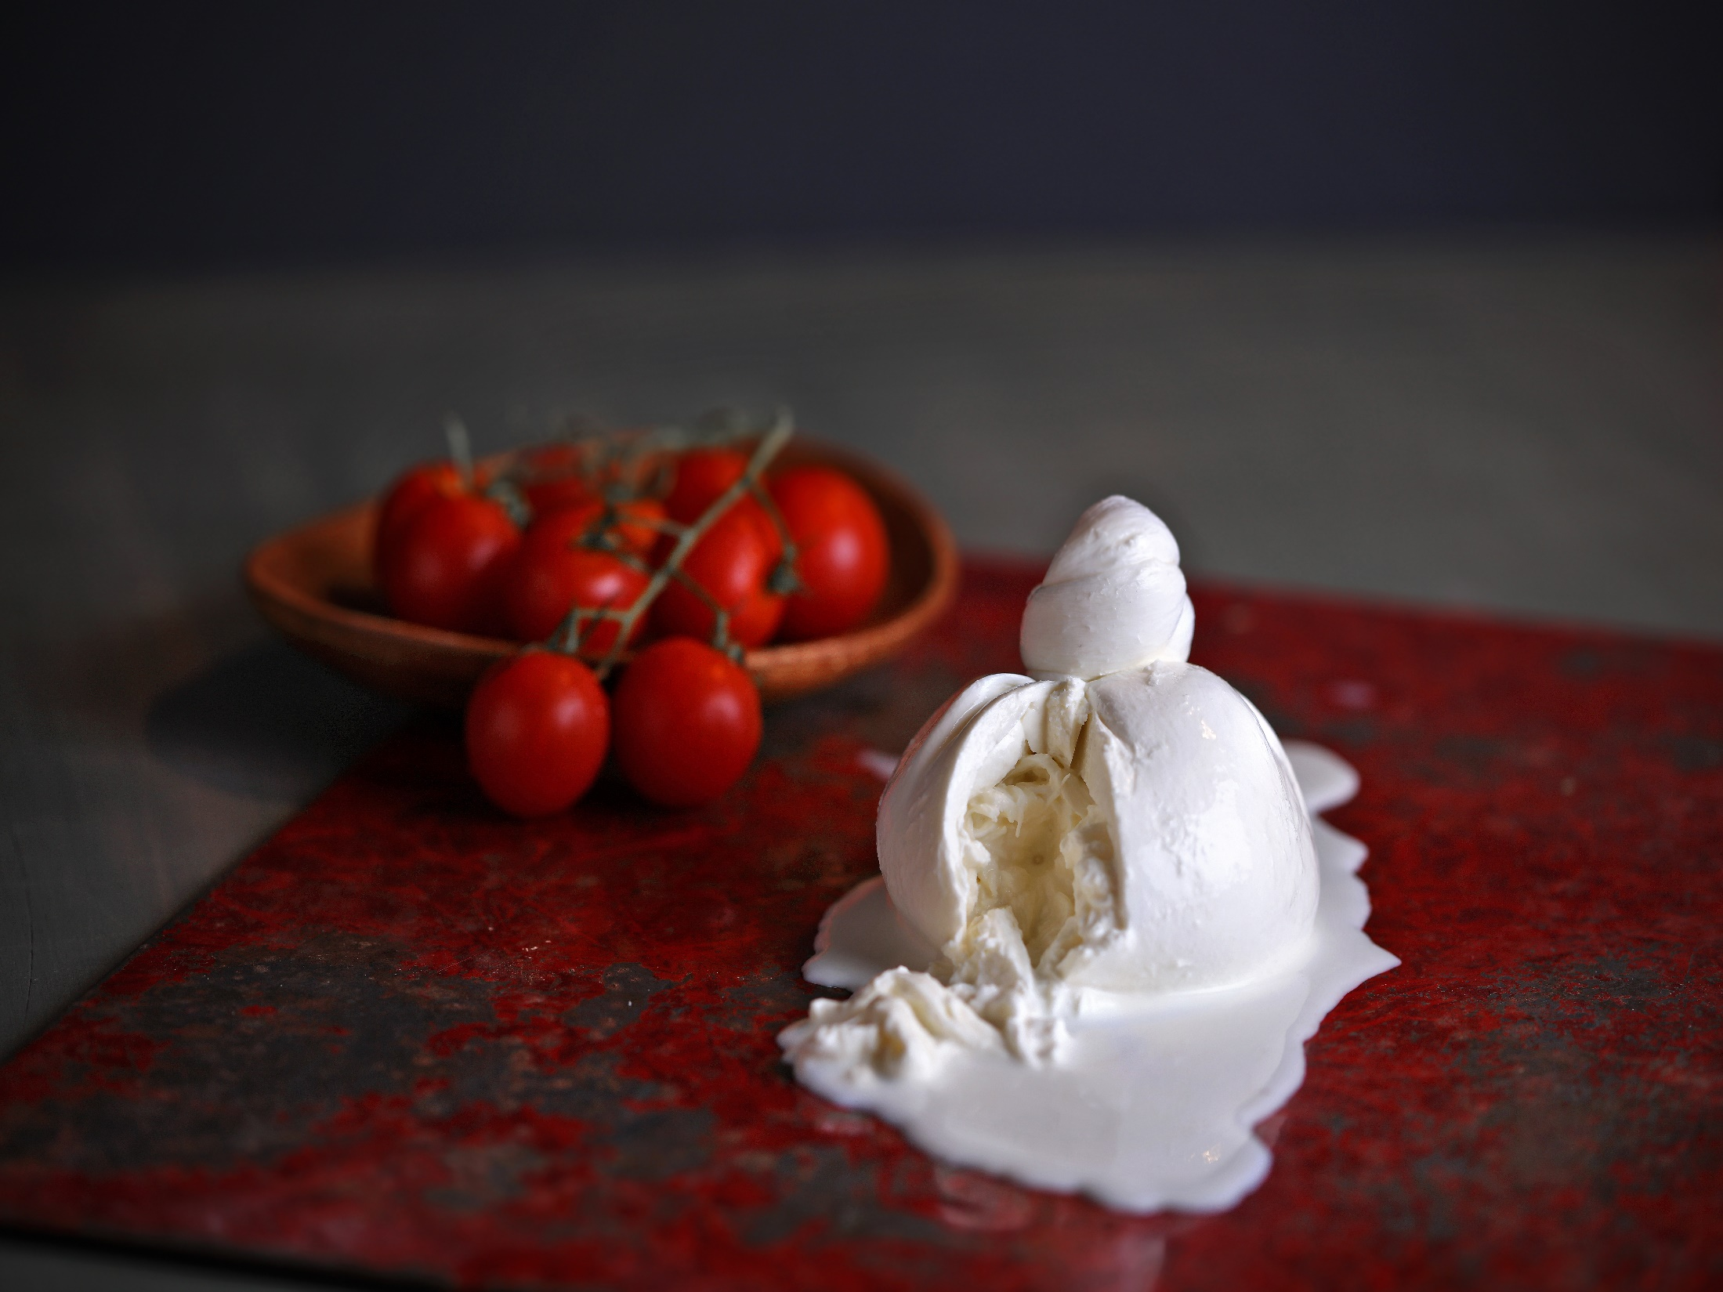
Our Hand-Crafted Burrata is a Winner!
2019 3rd Place-U.S. Championship Cheese Contest
2018 1st Place-American Cheese Society Competition
2018 1st Place-World Championship Cheese Contest

Slide 8
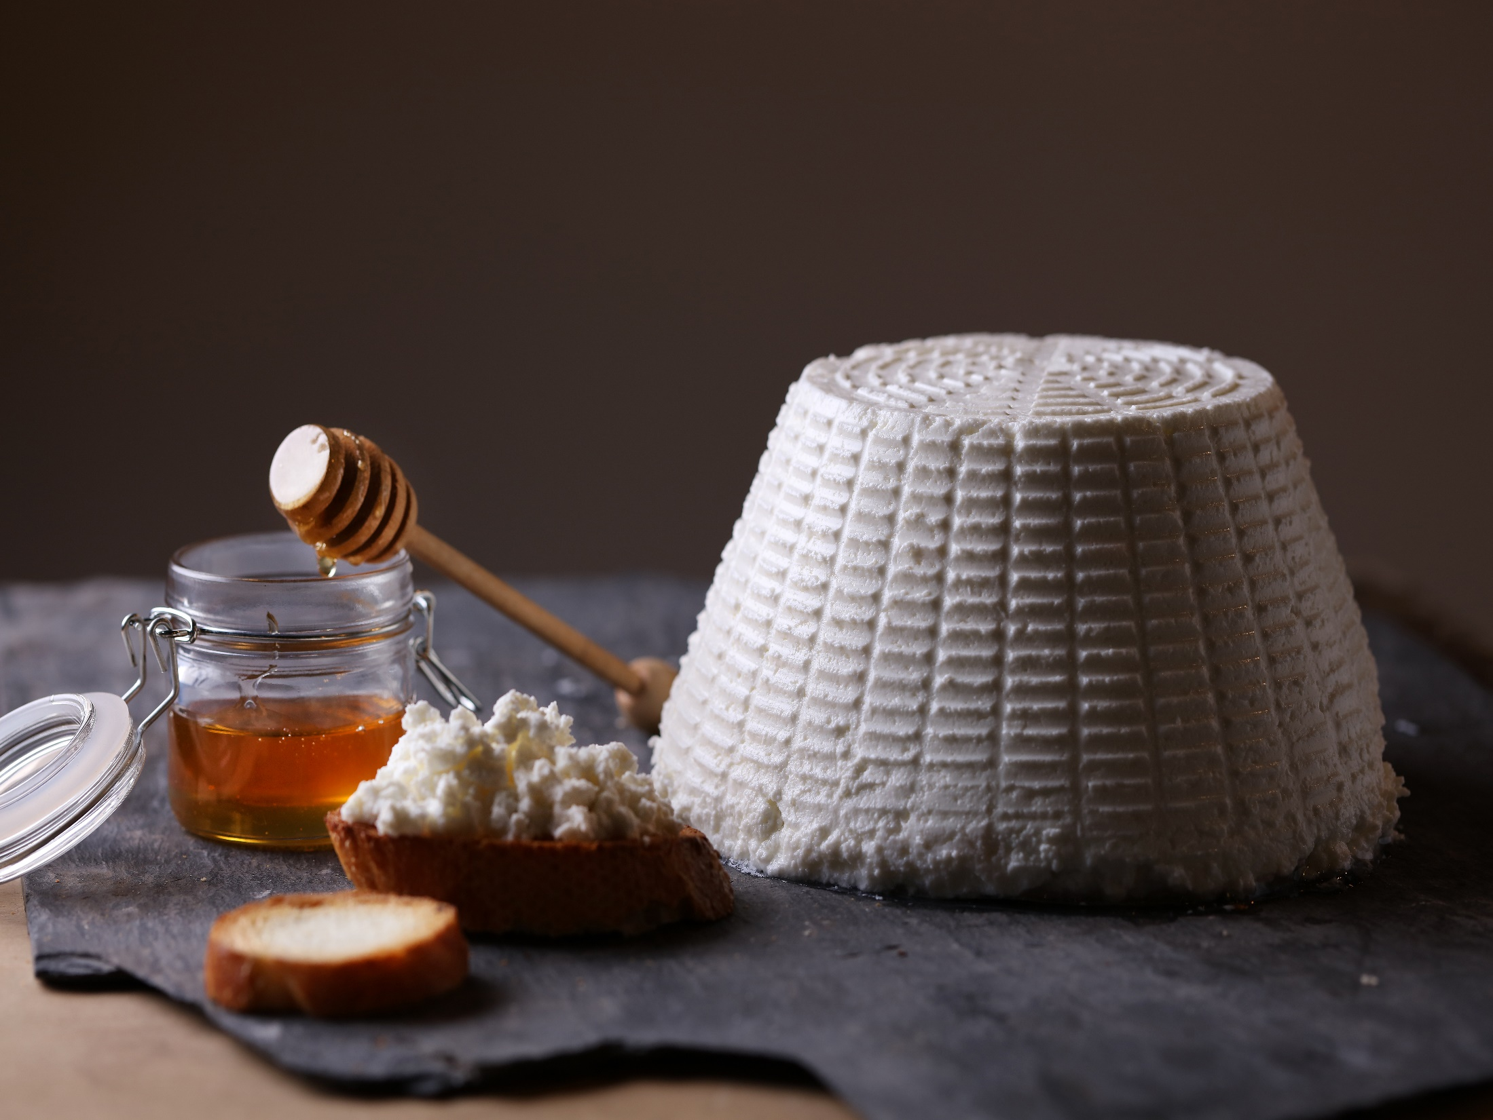
Caputo Hand Dipped Basket Ricotta is a Winner!
2019 1st Place-U.S. Championship Cheese Contest
2018 1st Place-American Cheese Society Competition

Slide 9
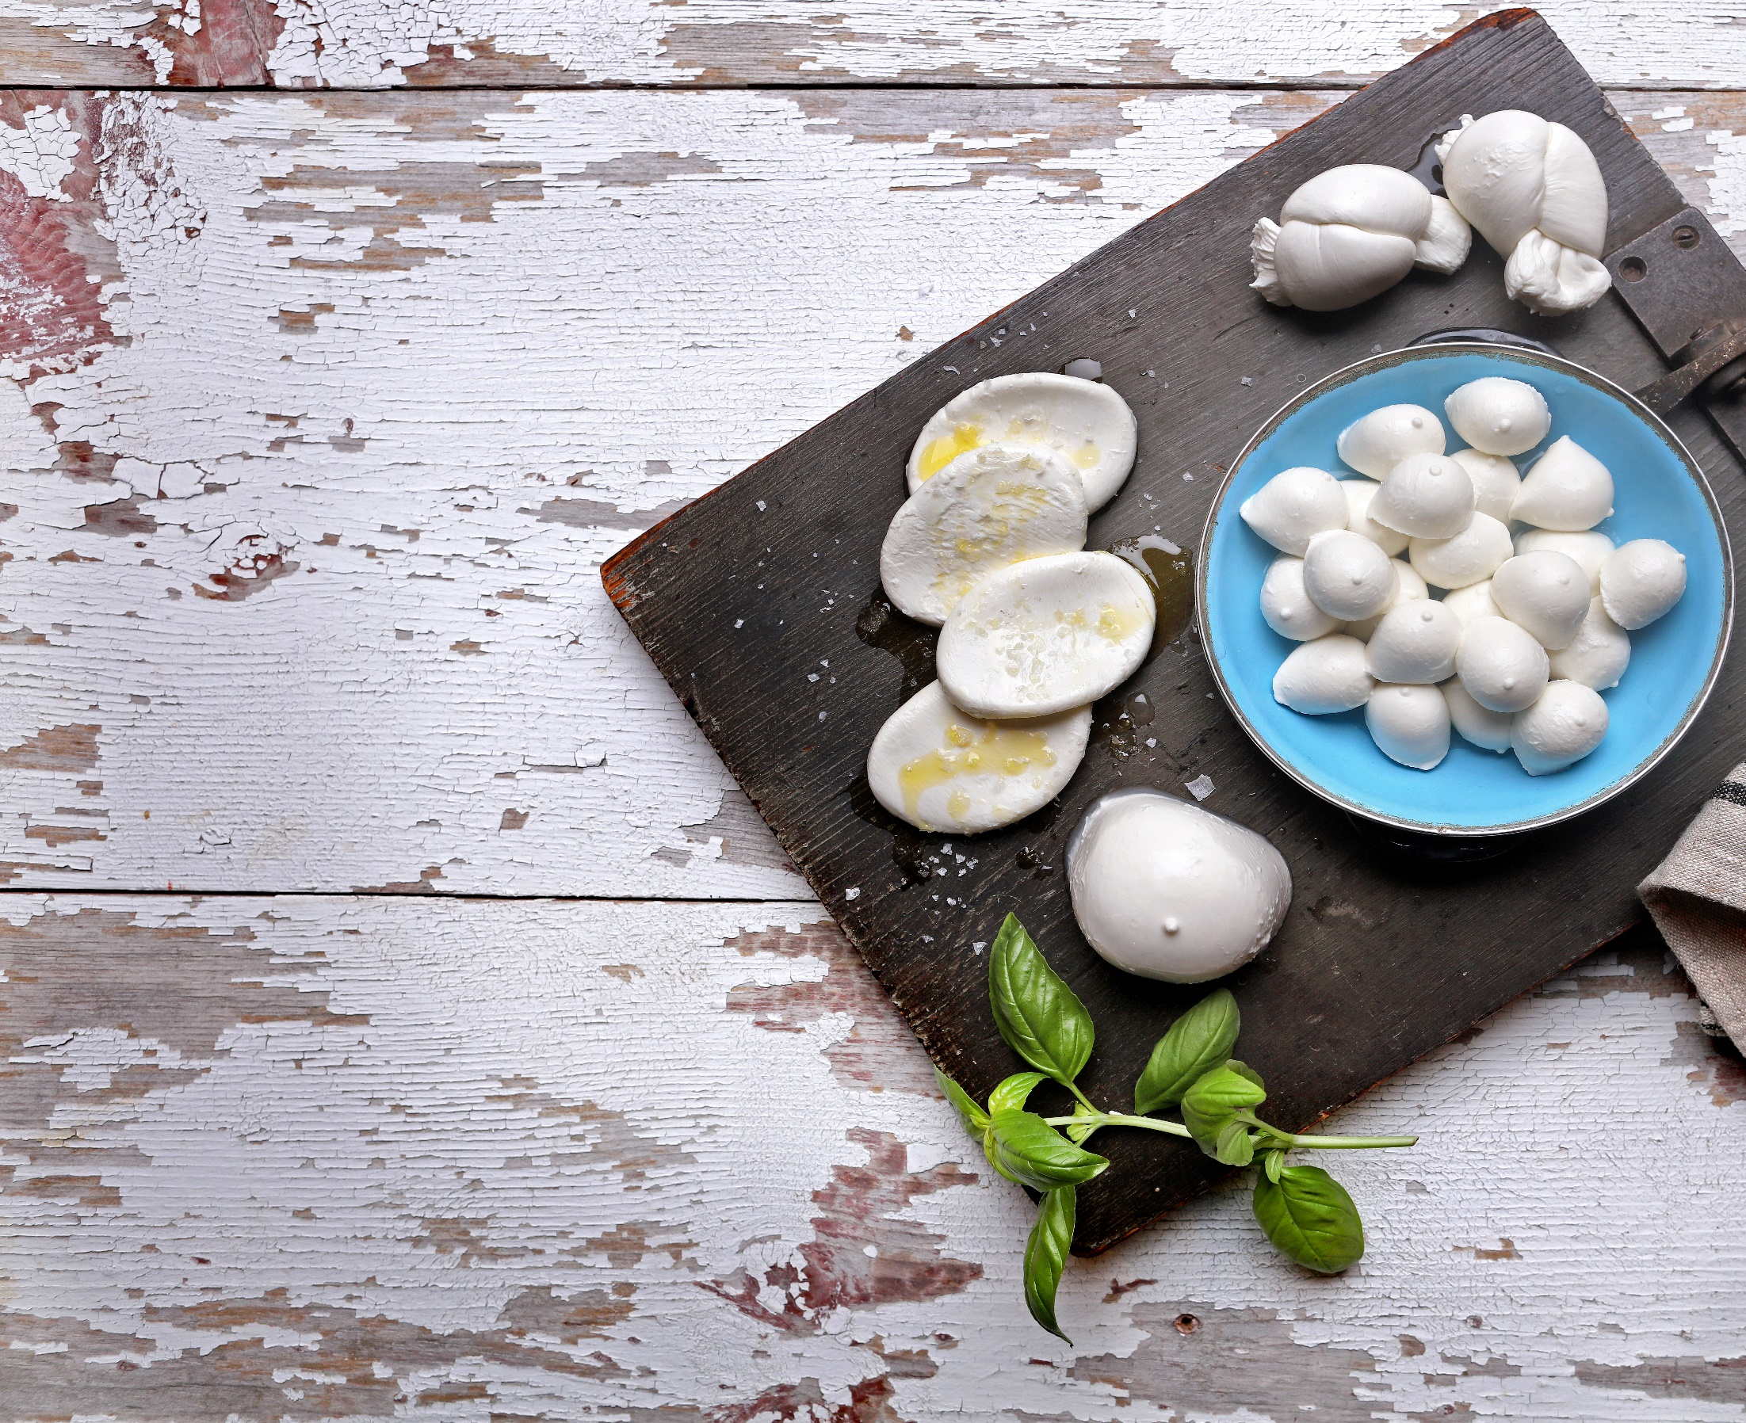
2019 3rd Place-U.S. Championship Cheese Contest
2018 1st Place- American Cheese Society Competition
2018 1st Place- World Championship Cheese Contest
Nodini Named One of the Best Cheeses of 2018
by Culture Magazine

Slide 10
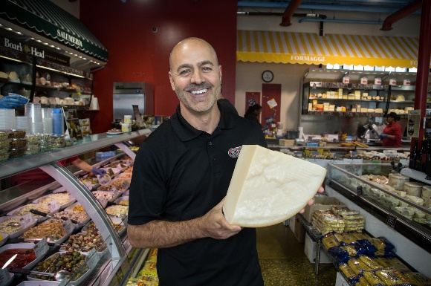
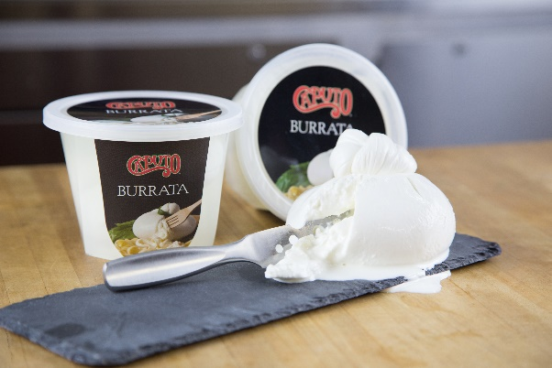
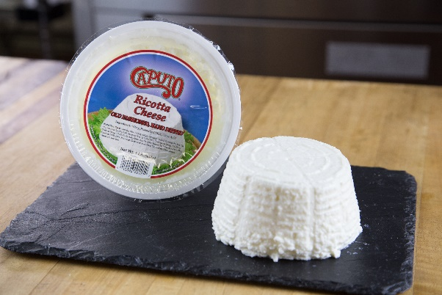
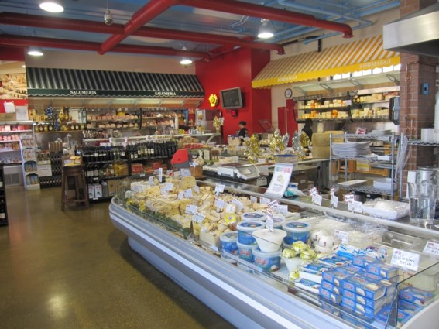
Caputo Cheese Market Melrose Park, IL Lake Forest, IL
Two locations with over 400 different cheeses in the case, 1000+ international and domestic in our inventory
A full service deli, made-to-order sandwiches, coffee and espresso at our Lake Forest location
Catering at your event, or platters to go
Full service kitchen at Melrose Park for wholesale customer
R & D

Slide 11
The Caputo Advantage
Experienced Management Team
Dedicated International Cheese suppliers
Flexible cheese formulations customized to individual customer needs
Aging- we have the experience, and space to age cheese to your specifications
Functionality/Specific Flavors or performance
Conversion/Cost
Shorter Lead Times
Strong Customer Service

Slide 12
Caputo Cheese: The Future is Now
We are committed to being the leading manufacturer of the highest-quality dairy products. Employee enthusiasm and dedication, along with innovation and family pride, are the driving force in our pursuit of customer satisfaction.
Since our beginning in 1978, Caputo has always been looking forward towards perfection. We’re constantly looking to improve our manufacturing, updating our facilities, expanding our capabilities, trying new recipes, and offering our customers items they can’t get anywhere else. Our promise is to never forget where we came from, and to never become complacent where we are.
Crafting Distinction

Slide 13
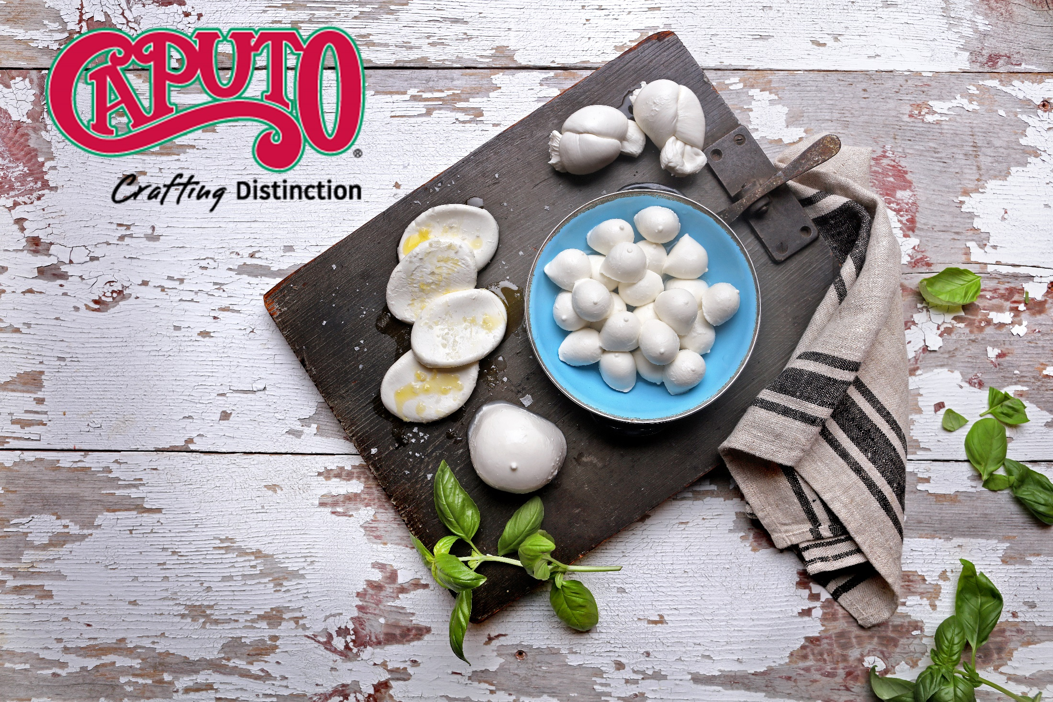
Caputo Cheese 2050 N. 15th Ave., Melrose Park, IL 60160
Tel: 708-450-0074 Fax: 708-681-1802 www.caputocheese.com

